Slide 1
Interview Trainer Agent
CAPSTONE PROJECT
Presented By:
Soumik Saran Nath – ITER SOA University – Computer Applications
Github:- https://github.com/soumik-24/IBM-Cloud-Project

Slide 2
OUTLINE
Problem Statement (Should not include solution)
Proposed System/Solution
System Development Approach (Technology Used)
Algorithm & Deployment
Result (Output Image)
Conclusion
Future Scope
References

Slide 3
Problem Statement
Preparing for a job interview can be an overwhelming experience, especially when you're unsure what to expect. While there are plenty of websites and platforms that offer general tips, they often fall short when it comes to providing personalized, role-specific guidance.
A fresher applying for a software engineering role and a professional switching to a managerial position have completely different needs—but most preparation tools treat them the same. There's usually no adaptation based on your experience level, industry, or even the type of company you're targeting.
What's missing is a smart, tailored approach—one that understands you as a candidate, analyses your resume or job role, and helps you practice with the right questions, model answers, and behavioral tips. The lack of such focused preparation not only lowers confidence but also affects real outcomes in competitive hiring environments.

Slide 4
Proposed Solution
To address the gap in personalized interview preparation, we introduce the Interview Trainer Agent—an AI-powered assistant designed to act like a personal interview coach.
Powered by Retrieval-Augmented Generation (RAG), the agent doesn’t just give generic tips—it actually learns about the user. When a user uploads their resume or mentions a job title, the system retrieves highly relevant data such as real interview questions, industry-specific expectations, and HR best practices from trusted online sources like job portals, professional communities, and interview databases.
Based on this information, the agent generates a custom preparation kit for the user. This includes:
Role-specific technical and HR interview questions
Common behavioral scenarios with suggested approaches
Model answers to help the user structure their own responses
Personalized improvement tips and follow-up guidance
The goal is to simulate the feeling of being coached by an experienced HR trainer—but in a digital, scalable way. This agent helps users not only practice smarter but also feel more confident walking into any interview, whether it’s for their first internship or their next big career move.

Slide 5
System Approach
IBM Cloud Lite Services:
IBM Watson NLP
IBM Cloud Functions (Serverless)
IBM Cloud Object Storage
IBM Cloud Lite Services:
IBM Granite Model (for answer generation and scoring)

Slide 6
Algorithm & Deployment
Algorithm Selection:
We adopted the Retrieval-Augmented Generation (RAG) approach, which combines the strengths of information retrieval and language generation. This was chosen to ensure highly relevant, role-specific interview preparation based on real-world data, instead of generating generic answers.
Data Input:
User inputs include resume text, job role, and experience level.
The retriever uses these inputs to search across recruitment portals, professional forums, and interview question datasets indexed as vector embeddings.
Training Process:
IBM's pre-trained Granite foundation model is used for generation.
A custom knowledge base (RAG corpus) is built.
The system doesn't require traditional model training but depends on effective data retrieval and prompt engineering for fine-tuning outputs.
Prediction Process:
When a user submits their details, the retriever pulls the most relevant interview content.
This context is passed to the Granite model, which then generates targeted questions, sample answers, and feedback tips.
The flow is hosted on IBM Cloud Functions with fast response and scalability.

Slide 7
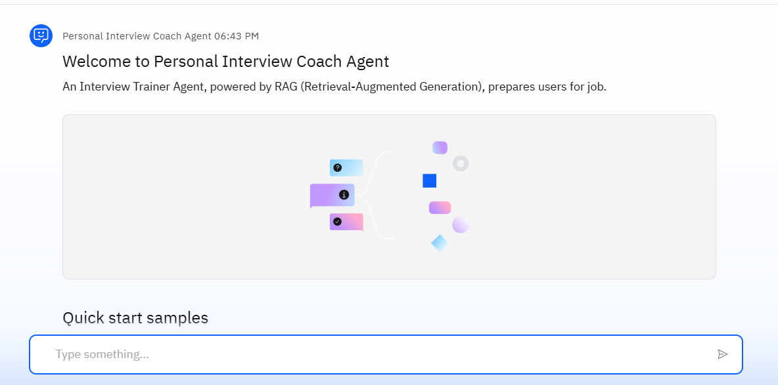
Result
Preview of the Agent

Slide 8
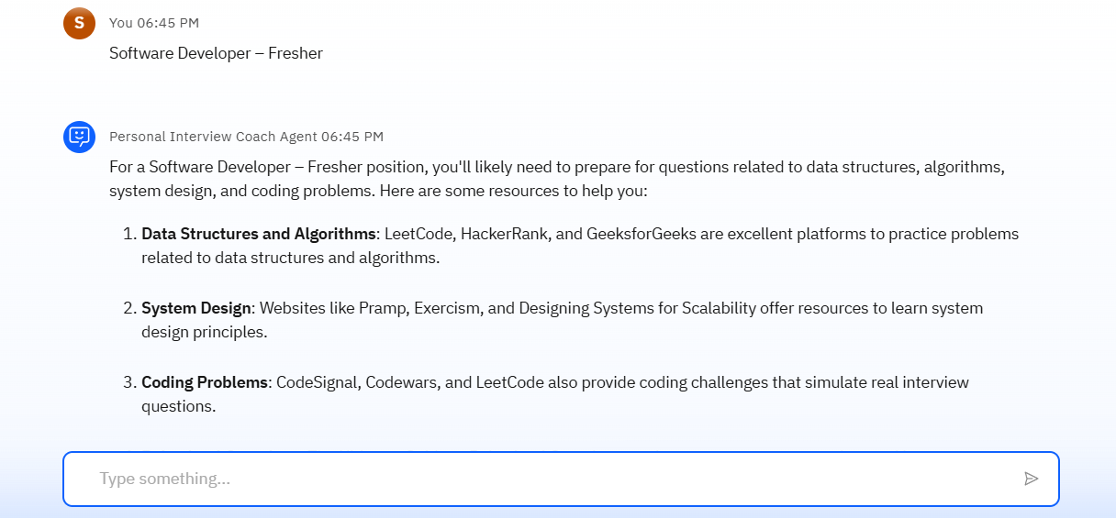
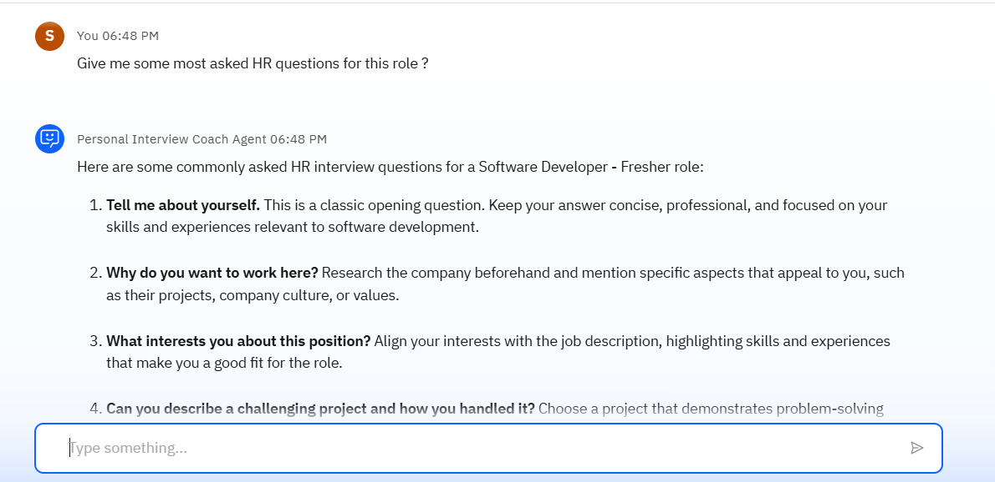
Input :- Software Developer – fresher
Input :- FAQ for this role

Slide 9
Conclusion
The Interview Trainer Agent represents a powerful and timely solution for one of the most stressful and high-stakes challenges faced by job seekers today—interview preparation.
By combining Retrieval-Augmented Generation (RAG) with IBM’s advanced Granite foundation models and scalable IBM Cloud Lite services, we’ve created a system that feels less like a chatbot and more like a personal interview coach. It’s smart enough to understand your job role, adaptive to your experience level, and capable of pulling in real-world, role-specific content to prepare you thoroughly.
Unlike generic prep apps, our system goes deeper—offering targeted technical questions, soft skill evaluation, and behavior-based feedback, all based on live and relevant data.
Whether you're a fresher stepping into your first interview or a professional aiming for a new role, the Interview Trainer Agent ensures you're never walking in unprepared.
This solution not only boosts confidence and performance but also demonstrates the potential of agentic AI in personal career development and education.

Slide 10
Future scope
Add voice-based mock interviews
Real-time answer scoring with feedback
Multilingual support
Integration with job portals or resume builders
Expand to group discussion and aptitude test training

Slide 11
References
IBM Granite Documentation
LangChain official docs
FAISS / IBM Cloudant for vector search
Job portals like Naukri, LinkedIn, Glassdoor
Papers on RAG and AI in EdTech

Slide 12
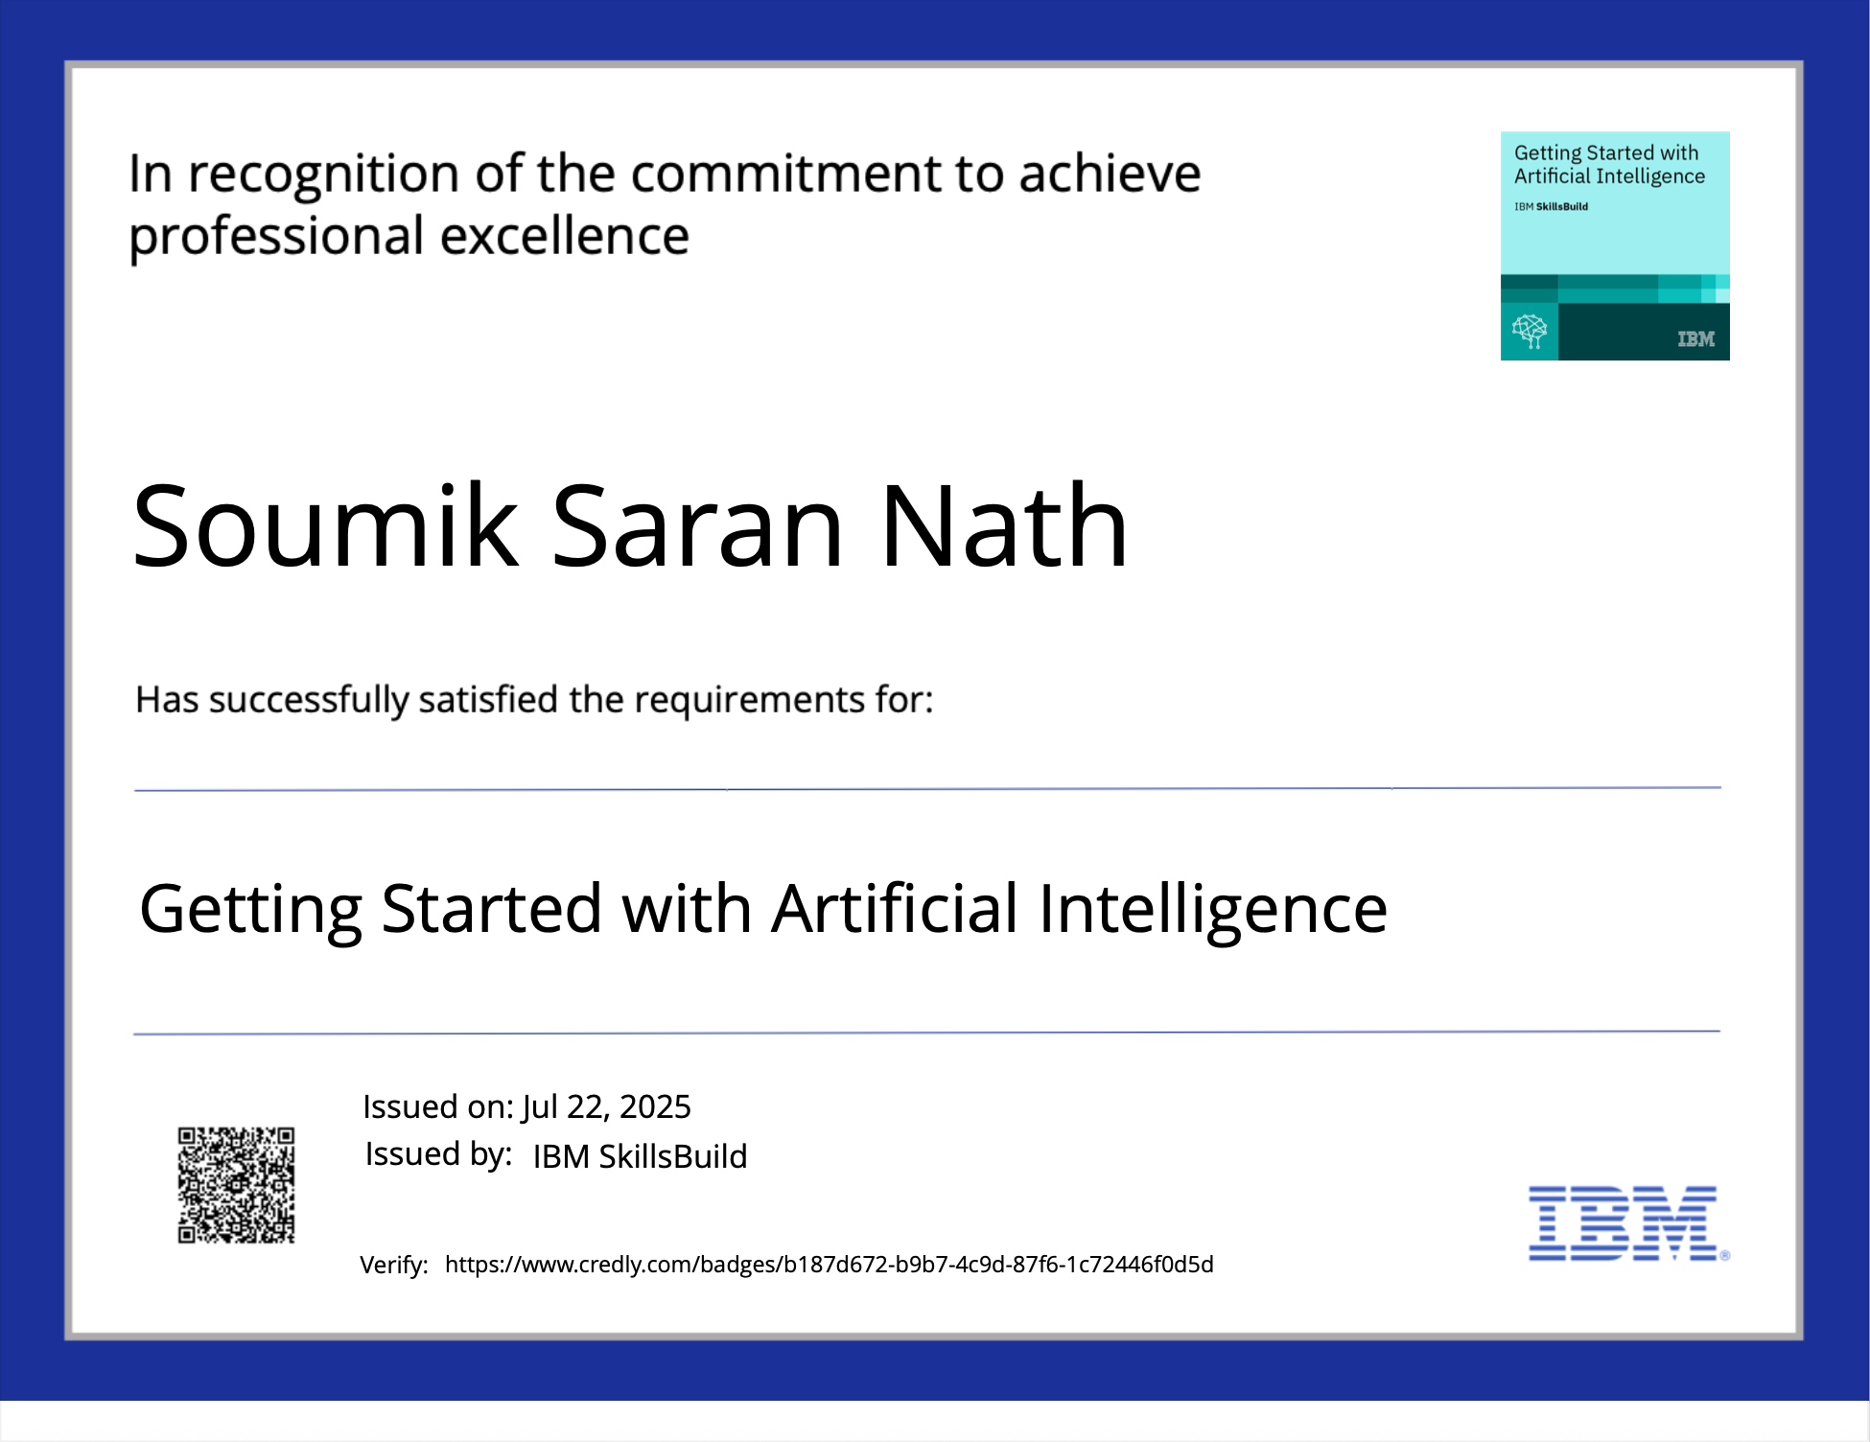
IBM Certifications

Slide 13
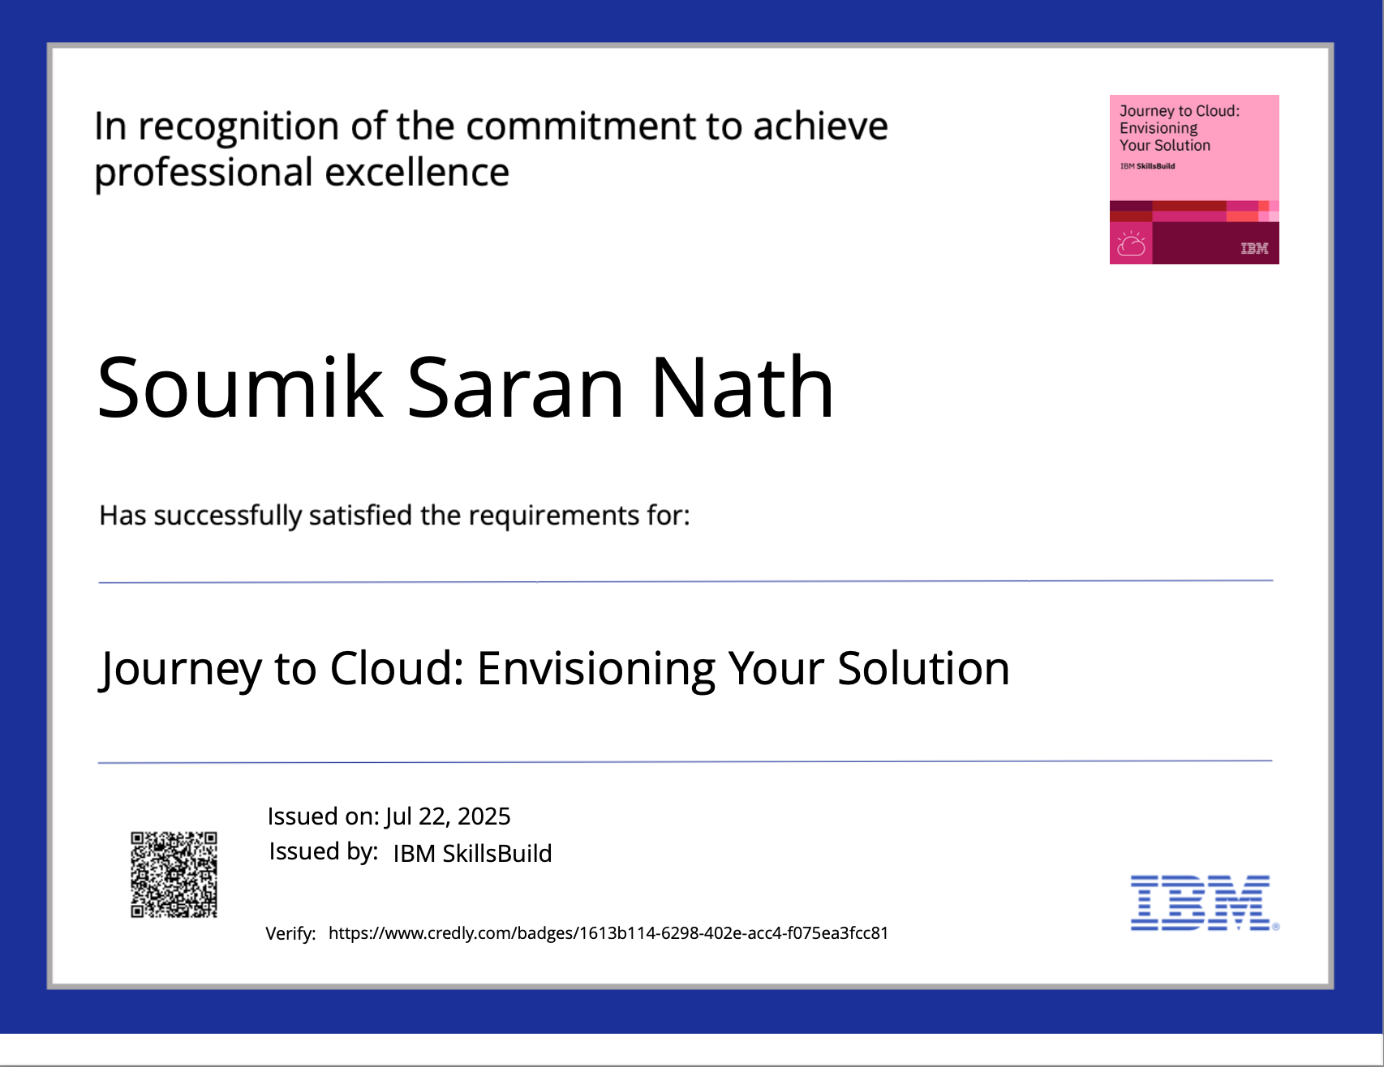
IBM Certifications

Slide 14
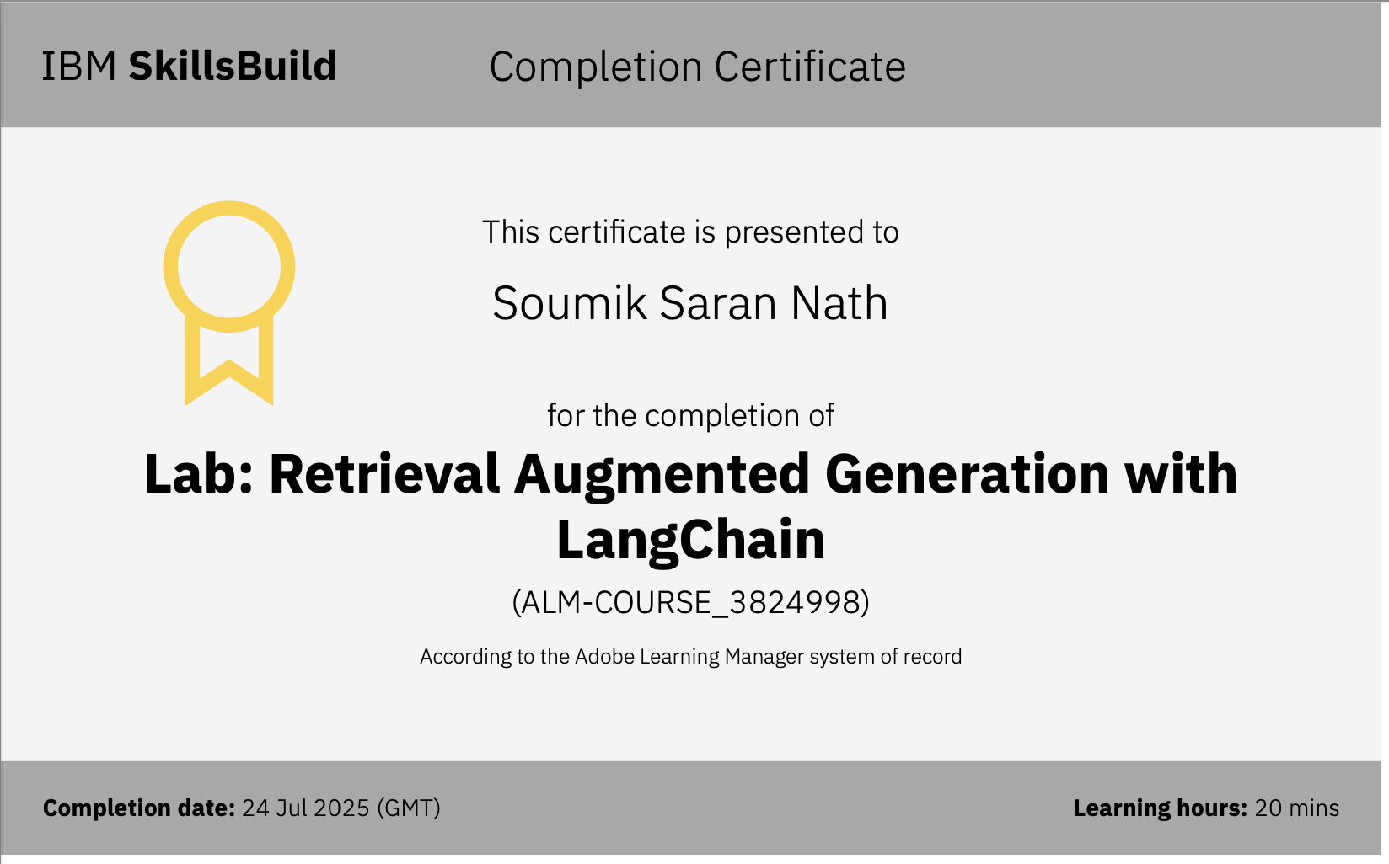
IBM Certifications

Slide 15
THANK YOU

